Slide 1
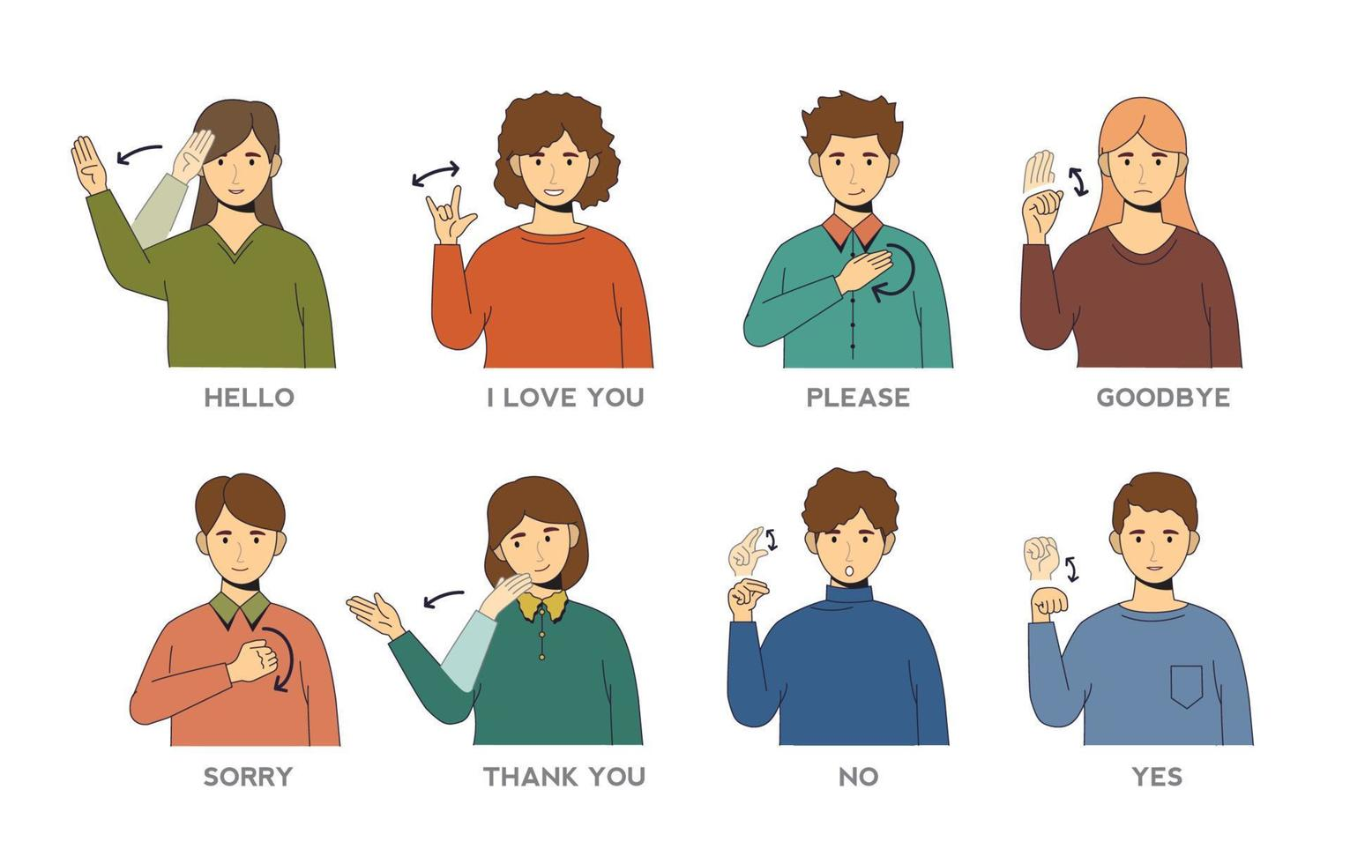
B.Tech CSE-AI 3rd Year Sign Language
Recognition
CAP-S101
Abhisar Singh Raghuvanshi(133) Anshika Sharma(137) Khushi Gupta(146)

Slide 2
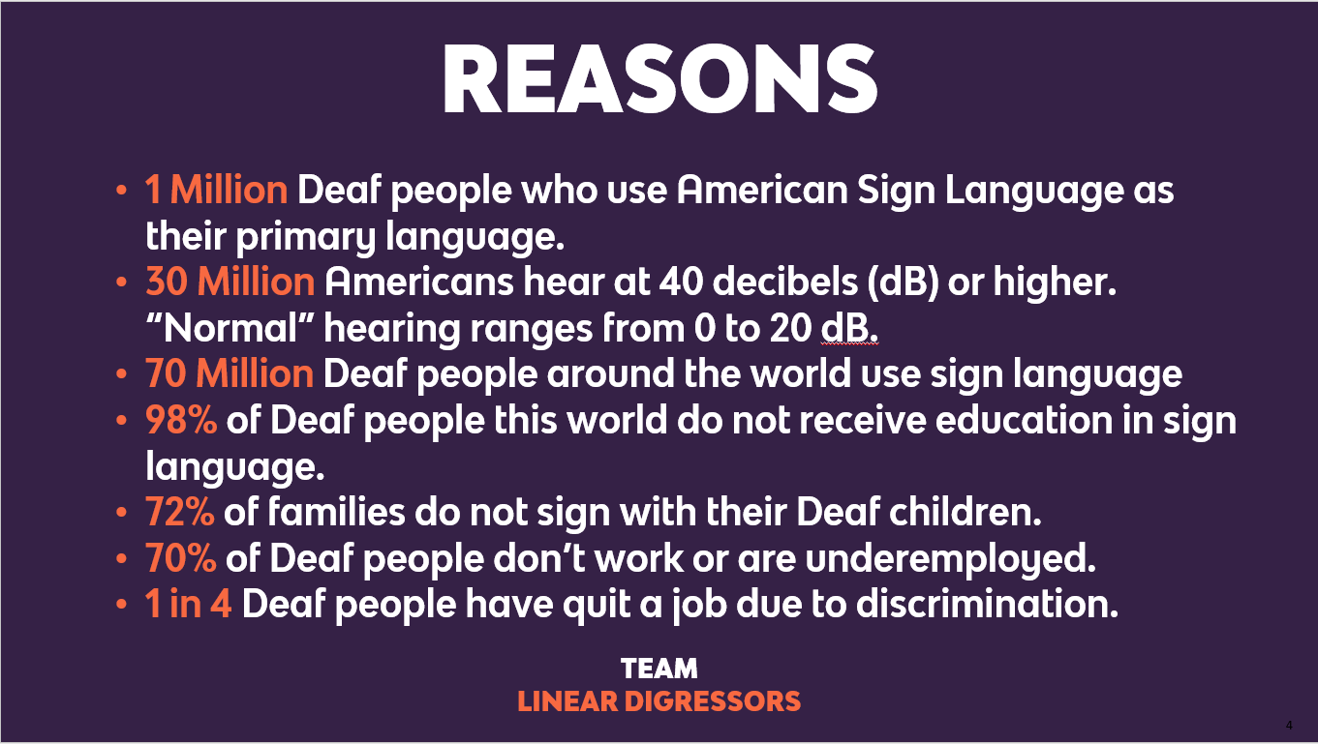

Slide 3
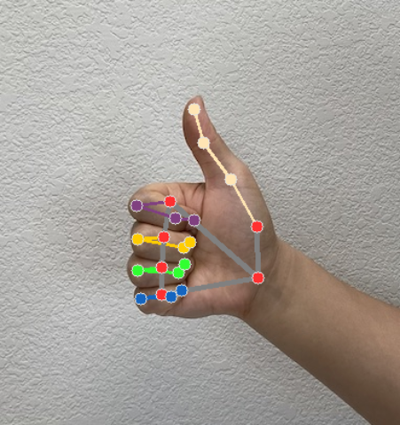
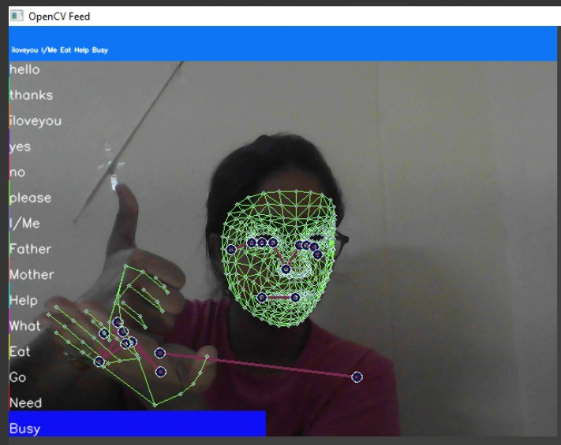
Introduction
Overview of Sign Language:
- Sign language serves as a vital visual language for the deaf and hard-of-hearing, facilitating effective communication and interaction.
Introduction to Gesture Recognition:
- Gesture recognition interprets human movements, enabling applications in human-computer interaction, healthcare, and sign language recognition.
Goal of the Presentation:
- The goal of this presentation is to showcase the implementation of sign language recognition using LSTM and MediaPipe Holistics for improved communication accessibility.

Slide 4
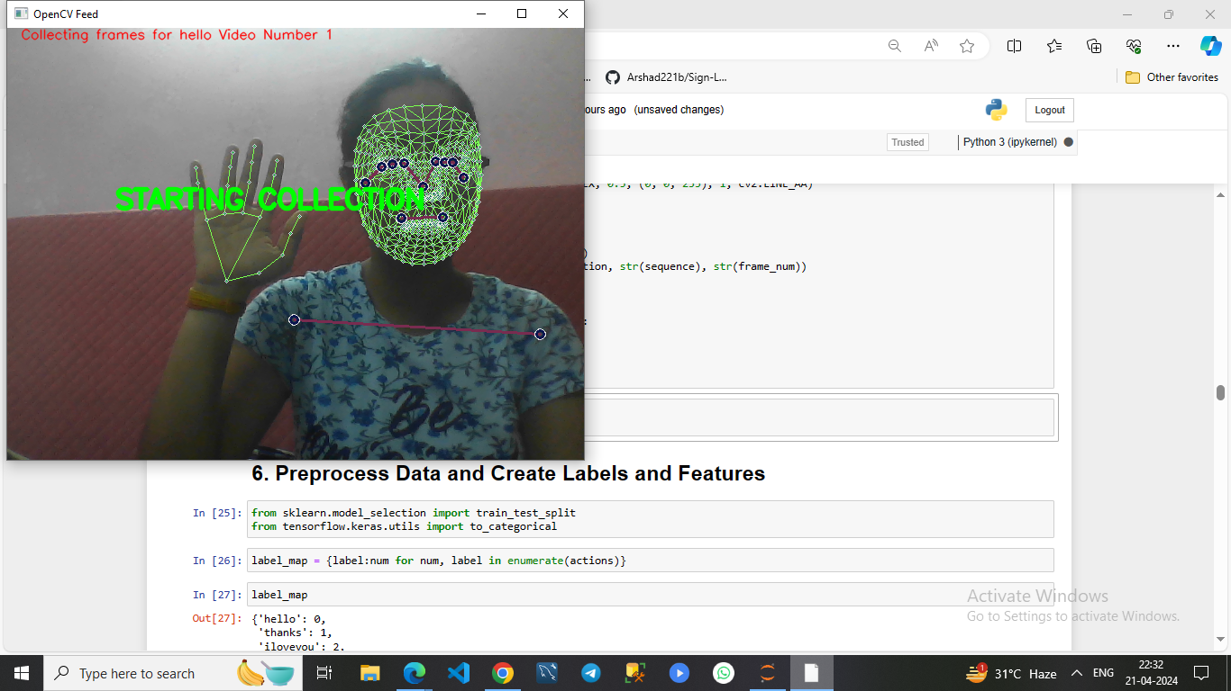
The sign language recognition pipeline encompasses several key stages, from capturing video input to predicting sign language gestures.
Capturing Video Input
Extracting Keypoints using MediaPipe Holistics
Preprocessing Data
Training LSTM Model
Real-time Prediction

Slide 5
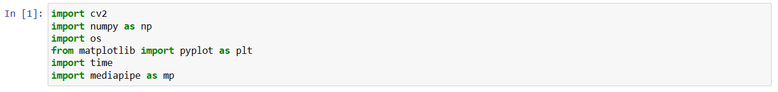

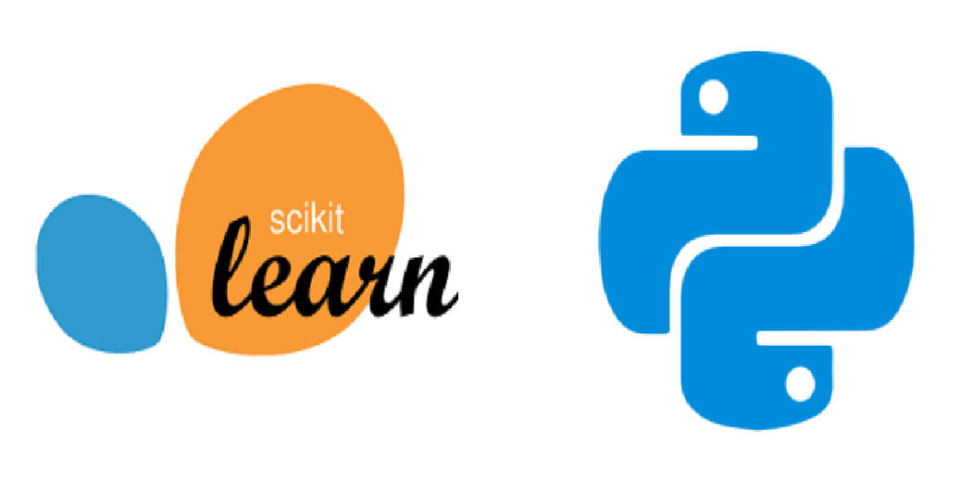


Importing Dependencies

Slide 6
Reasons For Using The Technologies -
1-OpenCV: Used for computer vision tasks such as video capture, image manipulation, and drawing on images.
2-Mediapipe: Utilized for holistic pose estimation and hand tracking, as well as for drawing landmarks on detected poses and hands.
3-TensorFlow: Employed for building, training, and deploying deep learning models, specifically for the LSTM neural network used in this code for gesture recognition.
4-Scikit-learn: Employed for its machine learning functionalities, such as data preprocessing (e.g., train-test splitting) and evaluation metrics (e.g., accuracy_score), which are utilized in training and evaluating the LSTM model for gesture recognition.
5-Os: module for interacting with the operating system
6-Time: module for time-related functions, both essential for file operations, system calls, and timing tasks in Python.
7-Scikit-learn:For data processing and evaluation metrics.

Slide 7
Technical Background: MediaPipe Holistics
MediaPipe Holistics:
→Developed by Google, it facilitates real-time detection and tracking of human body parts.
→Capabilities: It accurately detects and tracks multiple body parts such as the face, hands, and body pose.
→Key Features: Offers pre-trained models and pipelines for efficient keypoint extraction.
→Gesture Recognition: Utilized for extracting keypoint coordinates, crucial for analyzing and interpreting gestures.

Slide 8
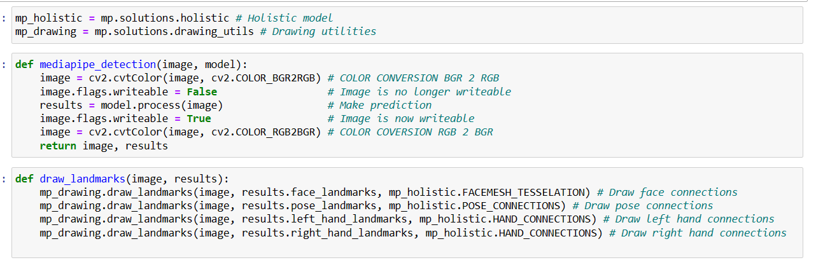
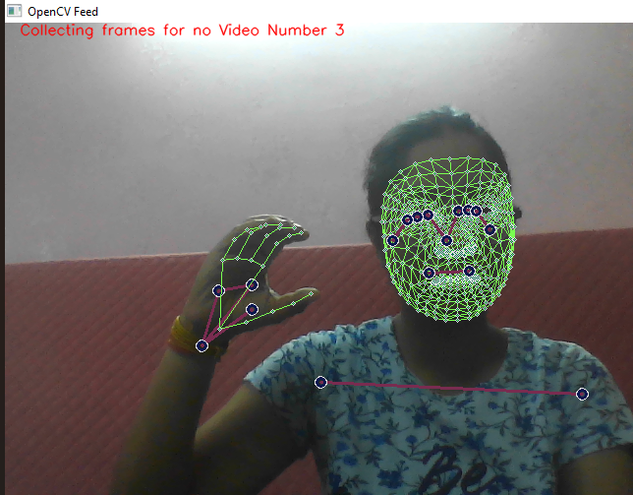
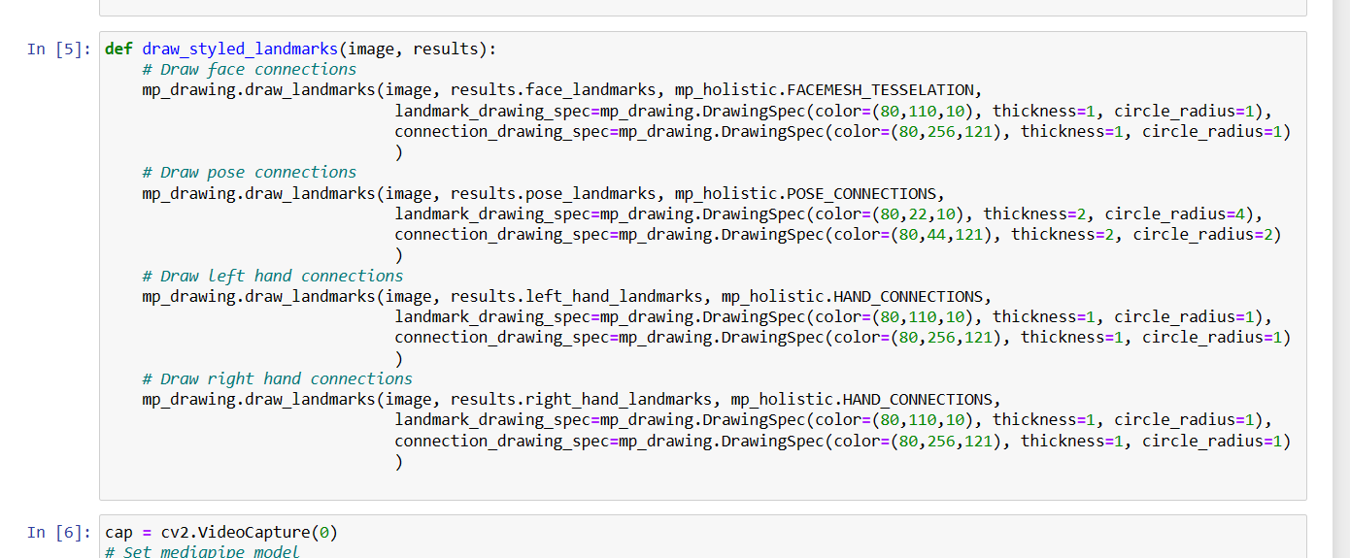

Slide 9
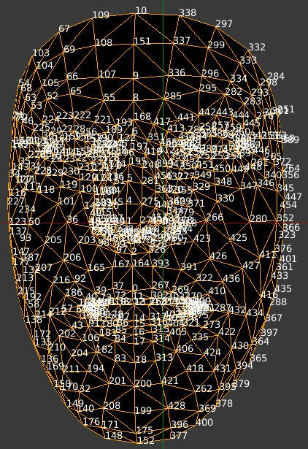
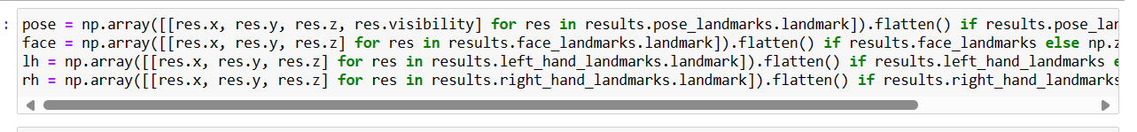
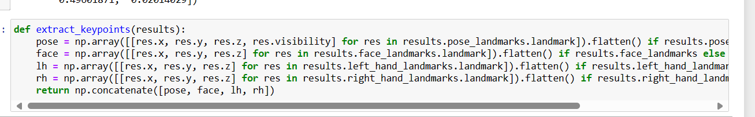
Keypoints Extraction
Keypoints Extraction:
Utilizes MediaPipe Holistics library for extracting keypoints.-
Process: Involves passing the input image through MediaPipe's pre-trained models for face, hands, and pose detection.

Slide 10

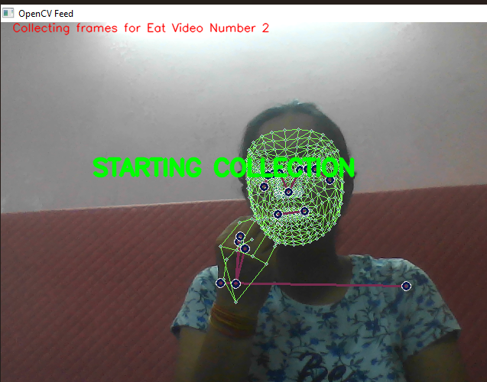
Data Collection
Individuals can record themselves performing sign language gestures using cameras or motion capture devices to create self-generated datasets.
NO
Hi
Eat

Slide 11
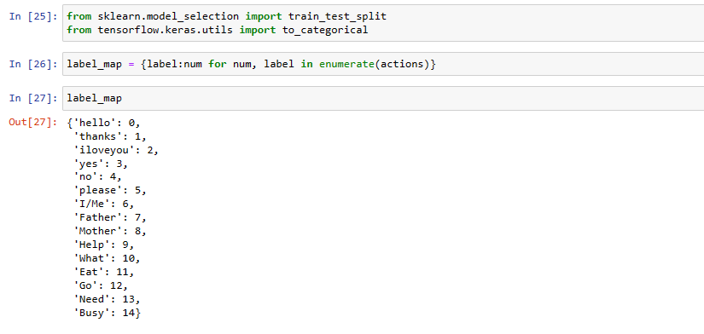
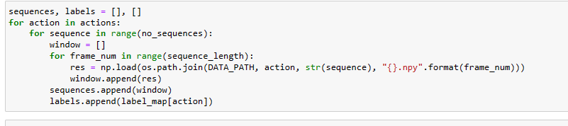
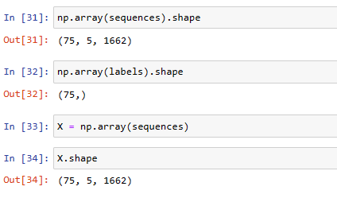
Preprocessing Data and Creating Labels and Features
1)Mapping Actions to Numeric Labels
2)Loading Data Sequences and Labels
3)Creating Features and Labels Arrays

Slide 12
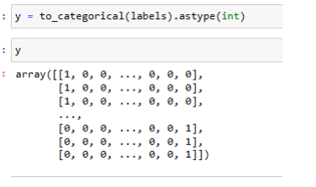
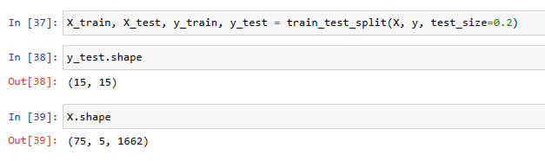
5)Splitting Data into Training and Testing Sets
4)One-Hot Encoding Labels

Slide 13
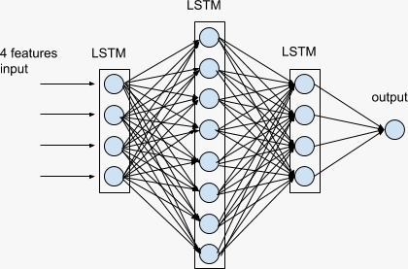
Technical Background: LSTM
LSTM (Long Short-Term Memory) networks are a type of recurrent neural network (RNN).
They address the vanishing gradient problem in traditional RNNs.- LSTM cells contain gates (input, forget, output) that regulate information flow.- These gates control the update of the cell state and output based on input data and past information.- LSTM cells can retain information over long sequences, making them suitable for tasks requiring memory over time.- They excel in handling sequential data with complex temporal patterns, such as gesture recognition tasks.

Slide 14
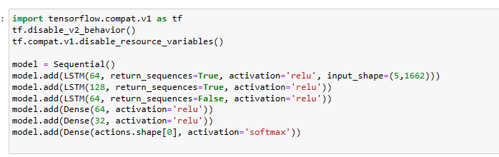
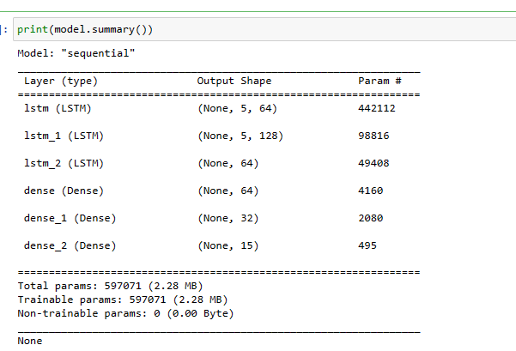
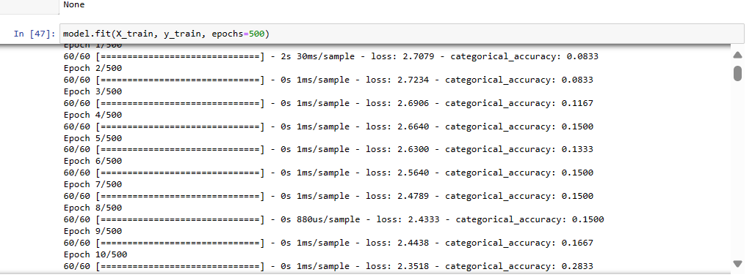

Slide 15
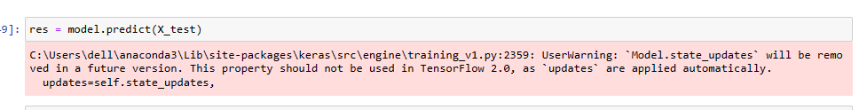
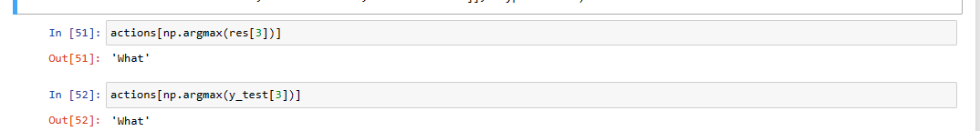
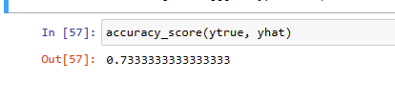
Making Predictions
Prediction on testing data
Actual vs Predicted action
Accuracy on testing data is 73.3%

Slide 16
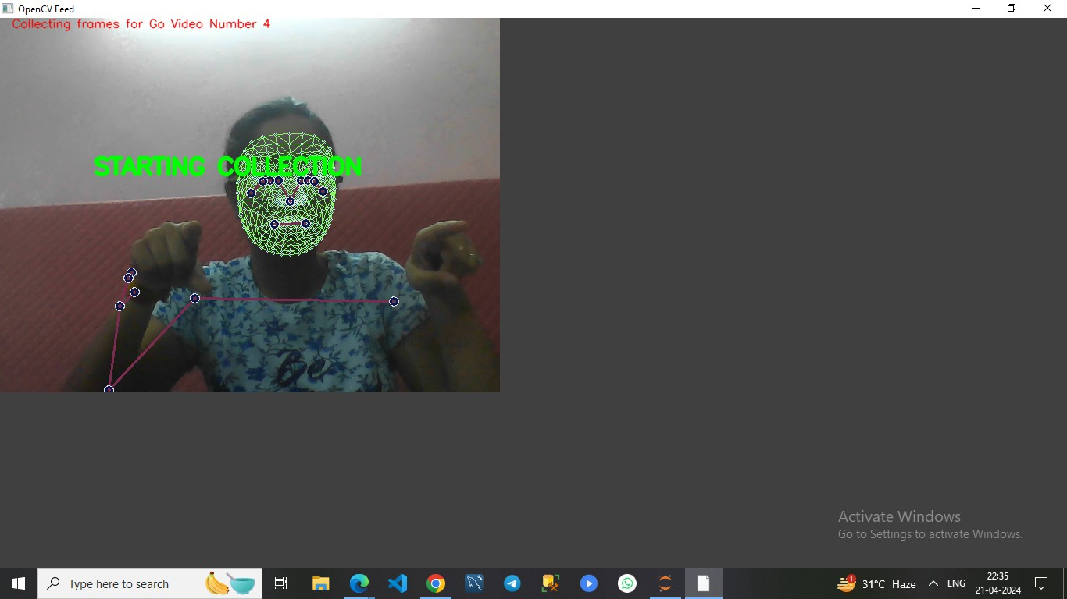
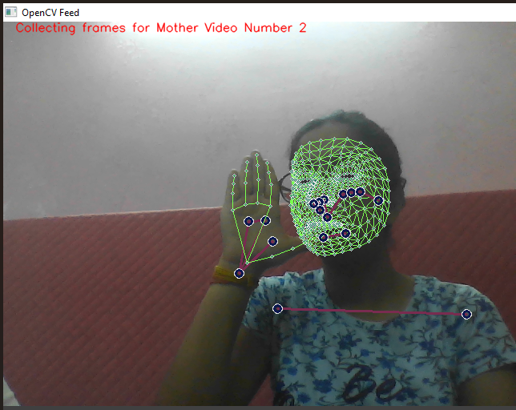
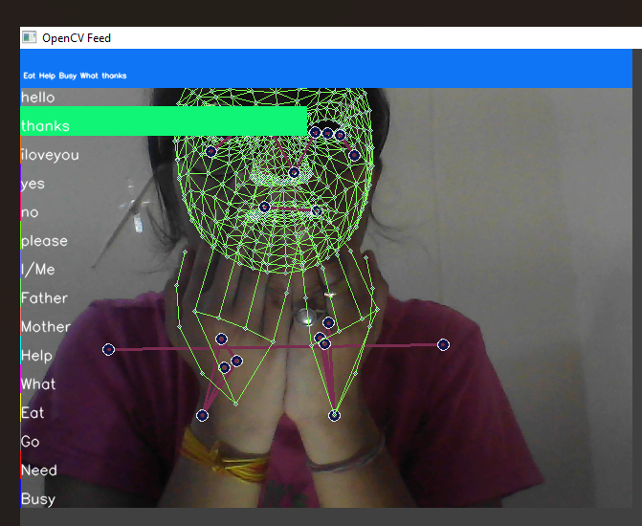
Real-Time Testing
Real-Time Video Feed Processing
Prediction Logic
Visualization and Display

Slide 17
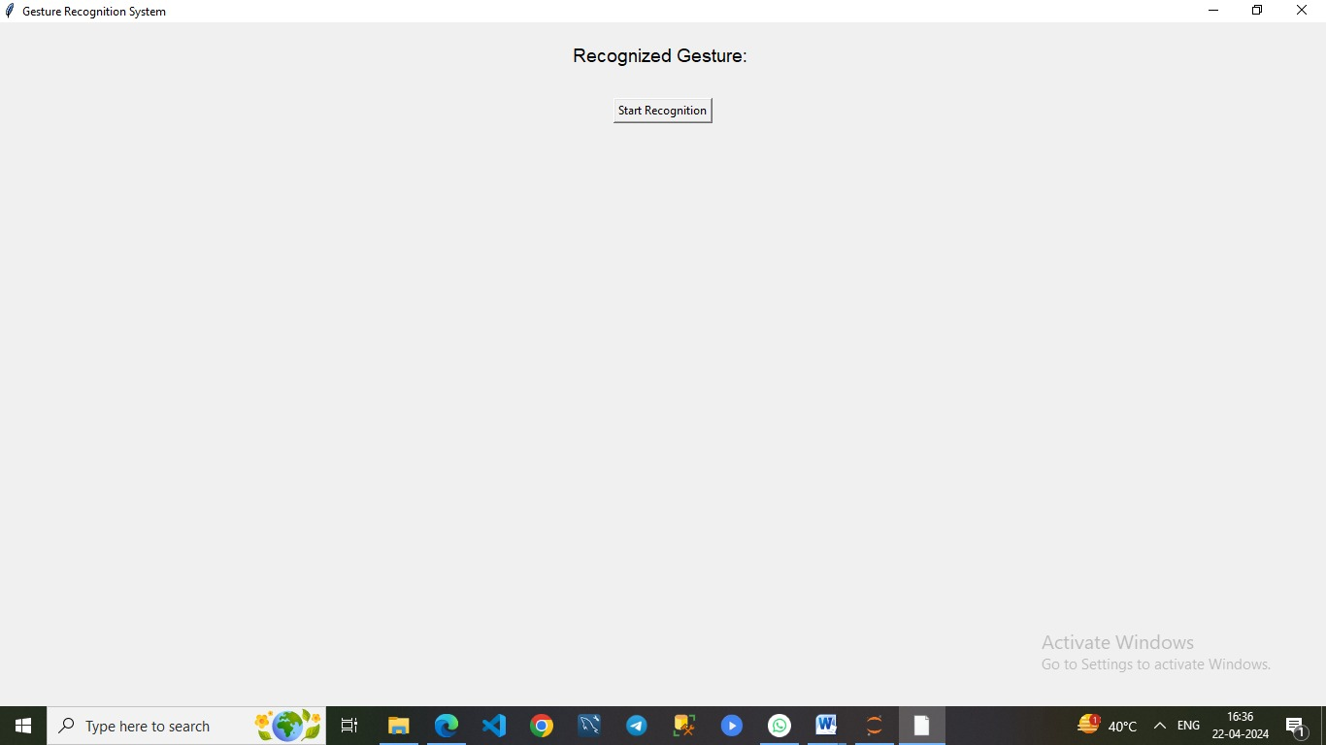
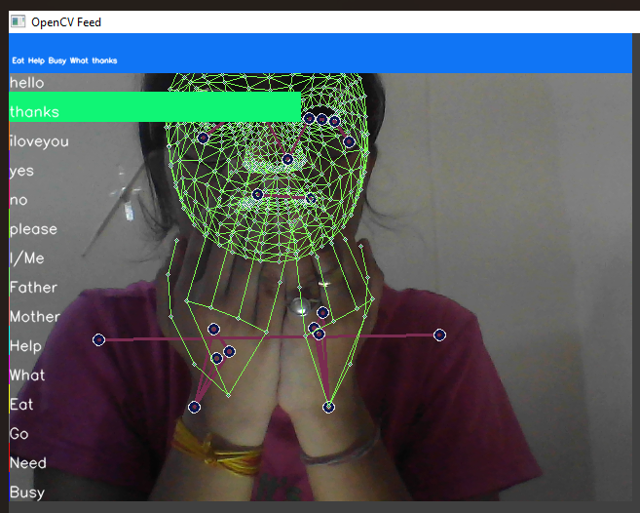
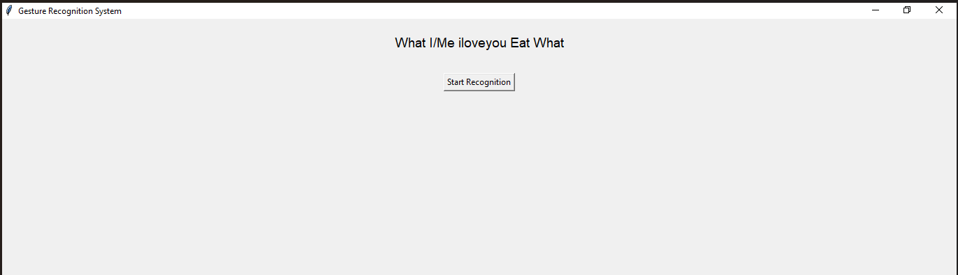
GUI Implementation

Slide 18
Applications and Future Directions
Applications:
Accessibility: Improve communication for deaf and hard of hearing in education, healthcare, and public services.
Education: Aid sign language learning with interactive tools and feedback.
Interpretation Services: Translate sign language in real-time for events and media.
Assistive Technology: Integrate with smart devices for daily tasks.
Future Directions:
Multi-modal Integration: Enhance accuracy with depth cameras or wearables.
Gesture Variation Handling: Improve recognition for diverse signing styles.
Real-time Performance: Optimize for low-latency communication.
Adaptation to New Signs: Continuously learn and adapt to evolving sign languages.

Slide 19
Challenges
Data Variability: Limited diverse datasets for training.
Gesture Ambiguity: Addressing multiple meanings of certain gestures.
Real-world Conditions: Handling lighting variations, occlusions, clutter.
Data Collection:- Collection of self generated data .
.

Slide 20
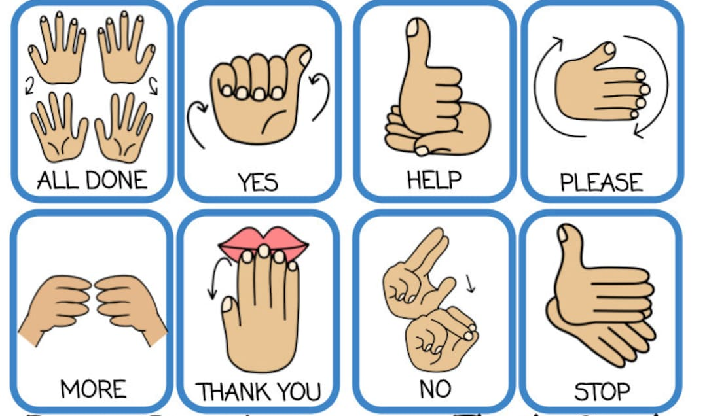
THANK
YOU !

